Slide 1
OBESITY PROJECT-FINAL PROJECT-2023-Abed Sanchez-CORRECTED-FLOW-040523
File created on: 11/16/2023 5:23:39 PM

Slide 2
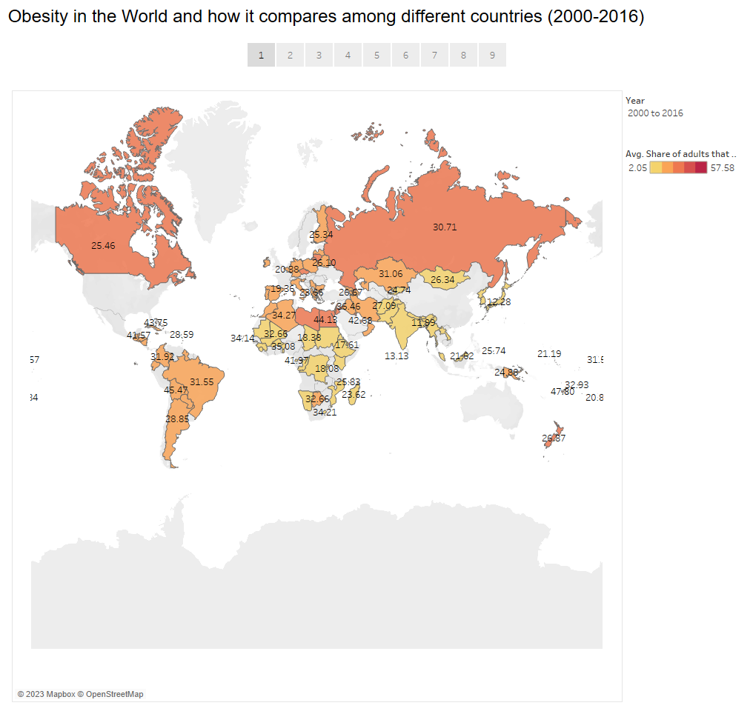

Slide 3
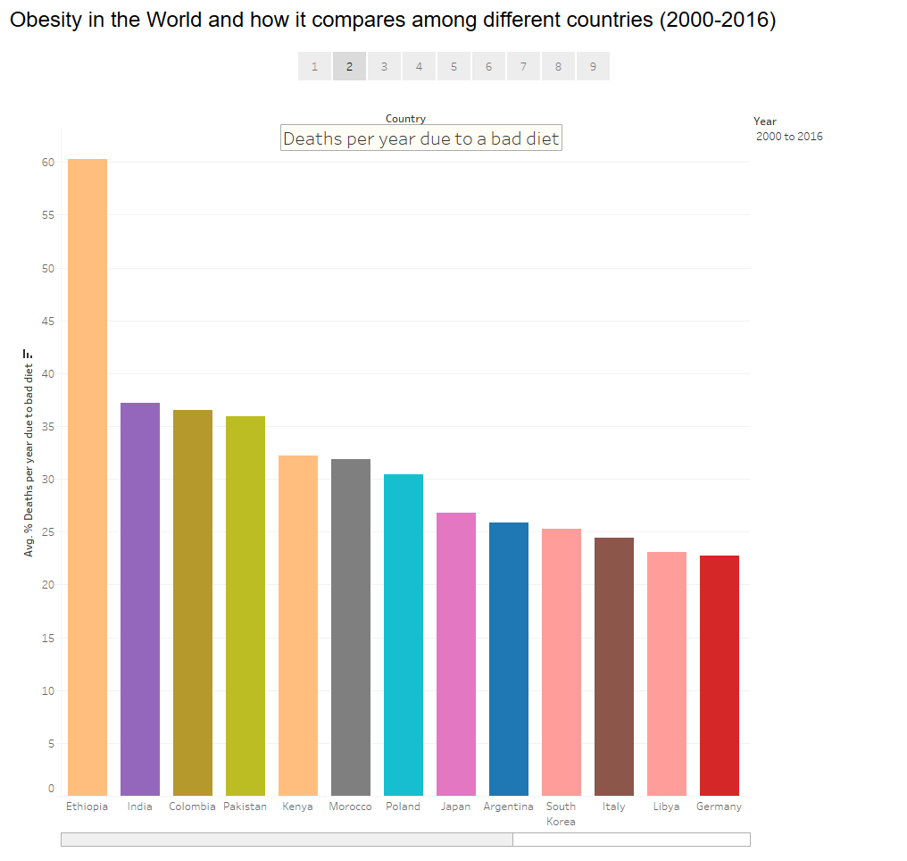

Slide 4
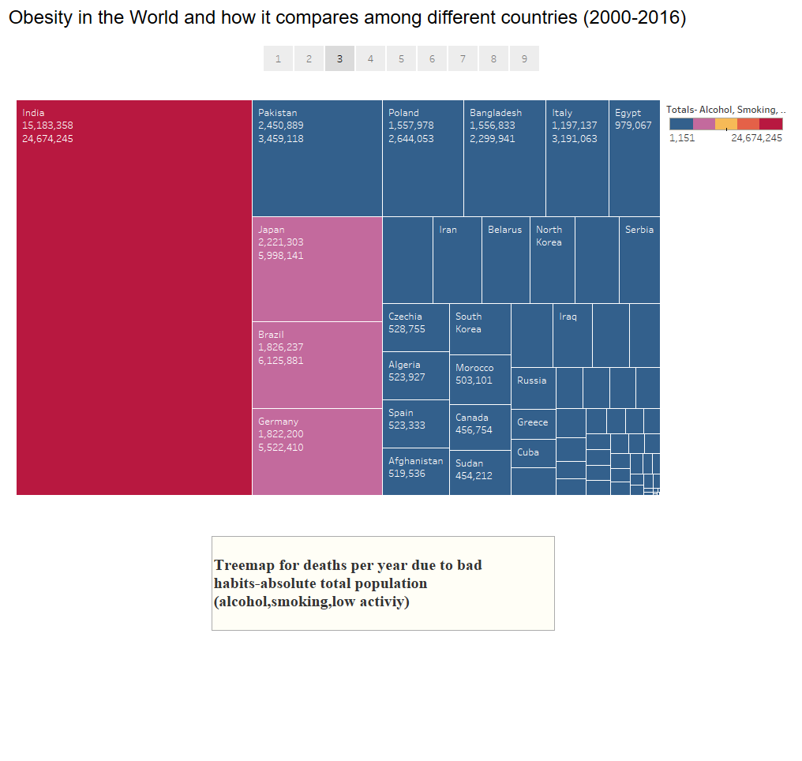

Slide 5
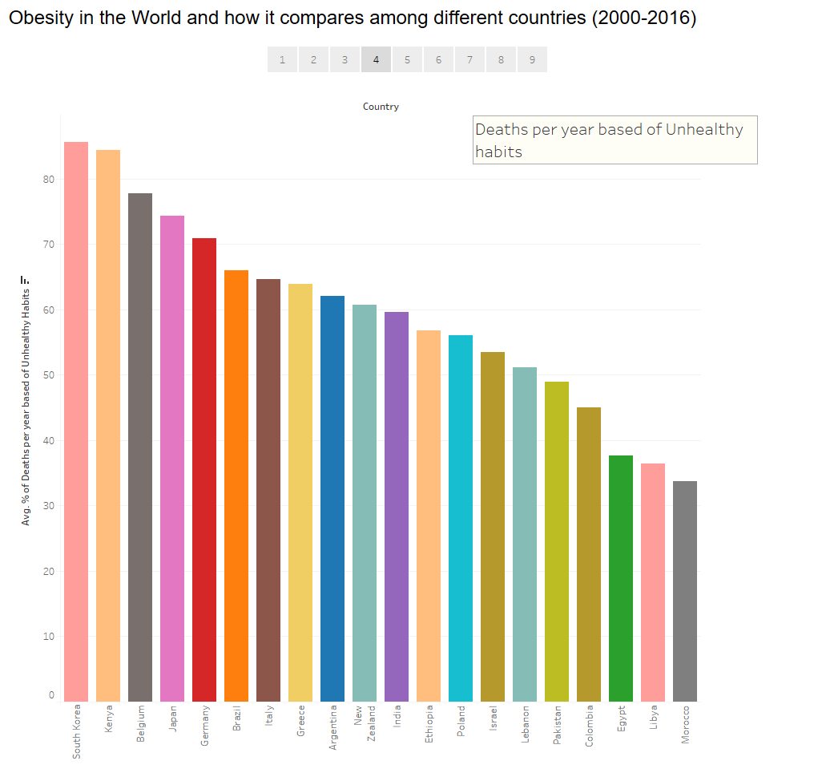

Slide 6
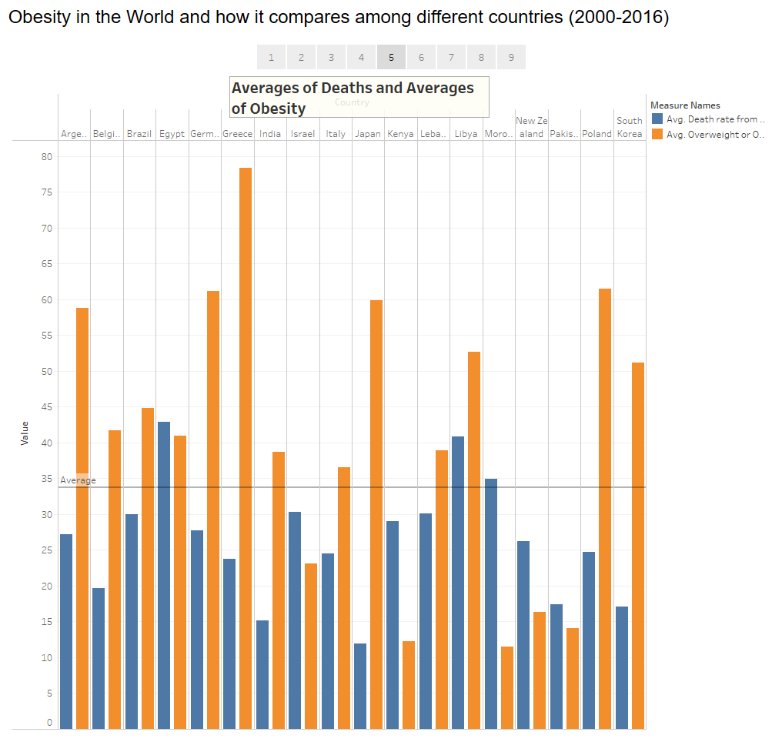

Slide 7
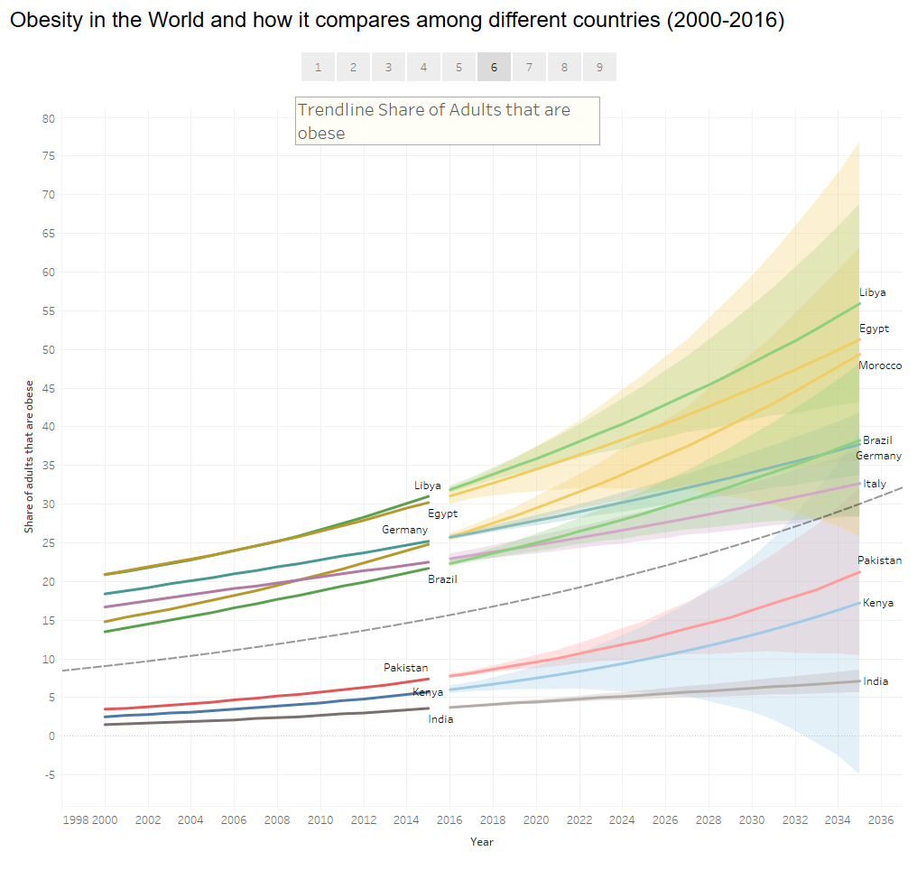

Slide 8
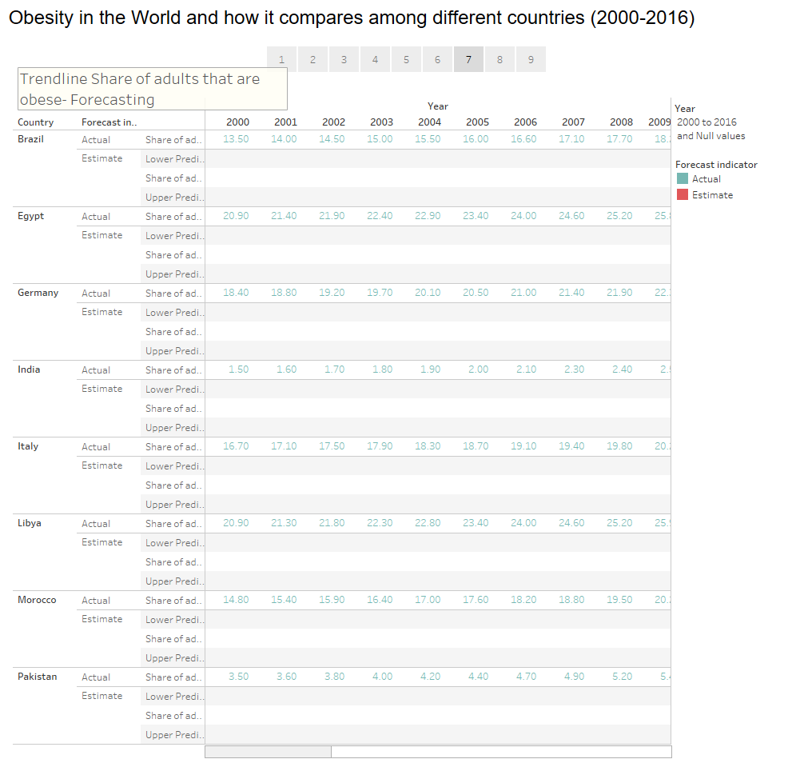

Slide 9


Slide 10
